Slide 1

Disaster Tweet Classification with NLP
NEXT HIKES IT SOLUTIONS
Project 7
9/14/2026
Monalisha Das

Slide 2
Agenda
Introduction and Project Overview
Data Overview and Exploration
Data Preparation and Feature Engineering
Modeling Setup
Model Comparison and Selection
Model Tuning and Evaluation
Deployment and Real World Use
2

Slide 3
Project Goal
Social media is a real-time sensor - During fast-moving events, tweets arrive in huge volumes and minutes matter.
Signal is mixed with noise - People use disaster words casually, so raw keyword searches over-alert teams.
Classification improves focus - Reliable labels help analysts prioritize likely emergencies in high-noise streams.
Binary tweet classification
Predict whether a tweet describes a real-world disaster or not.
Turn noisy, short text into a clear signal for downstream triage.
Supervised learning approach
Train on 7,613 tweets that were hand-labeled with 0/1 targets.
Learn patterns from language and phrasing, not external context.
Practical detection focus
Optimize for dependable classification performance, not perfect interpretation.
Support rapid filtering so humans can review high-impact cases faster.
Introduction and Project Overview
3

Slide 4
Dataset At A Glance
What’s in the data
7,613 tweets are hand-labeled as disaster or not.
Each row includes id, text, plus keyword and location fields.
Why this scale works
It supports fair model comparison, tuning, and a held-out test set.
Real-world noise in tweets makes this a practical benchmark dataset.
Missing fields to plan around
61 tweets have no keyword, so keyword-based insights are partial.
2,533 tweets have no location, limiting geo-specific analysis.
Duplicates that can bias results
110 tweet texts repeat, which can inflate performance if not handled
Data Overview and Exploration
4

Slide 5
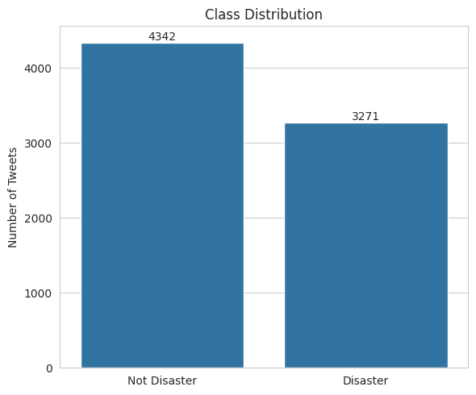
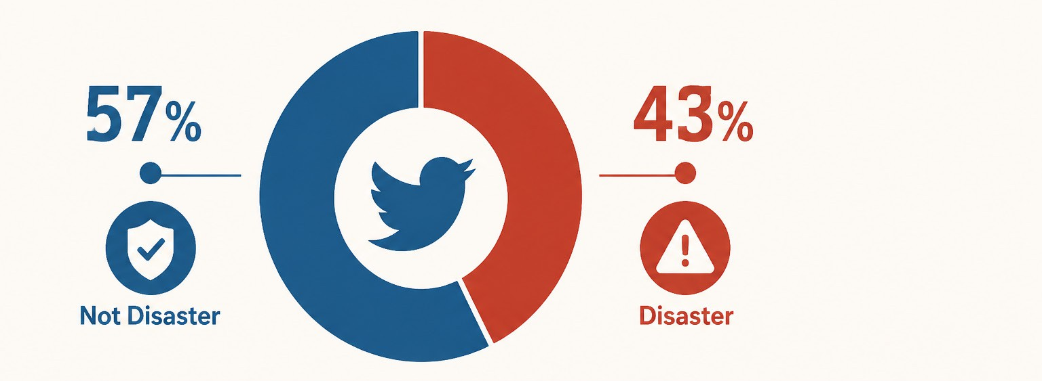
Target Distribution
Overall class mix
About 57% of tweets are labeled Not Disaster.
The remaining 43% are labeled Disaster.
Why balance matters
The split is close enough to avoid severe imbalance issues.
Using F1-score is appropriate because it balances precision and recall.
Data Overview and Exploration
5

Slide 6
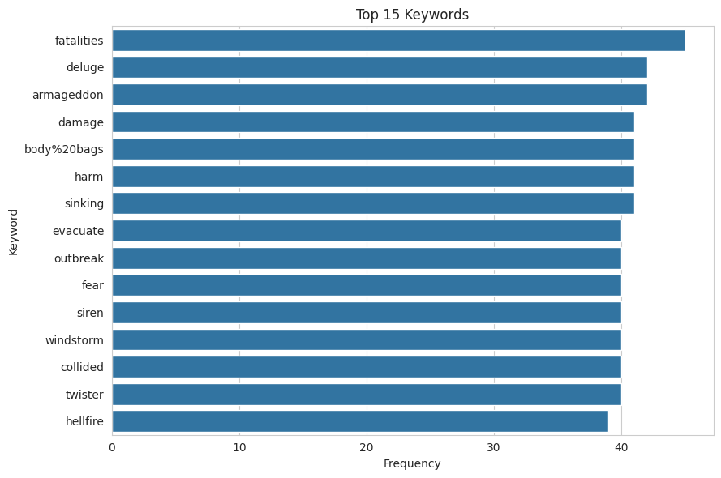
Early Data Signals
Keyword patterns surfaced early
High-frequency keywords quickly revealed recurring disaster-related themes.
Keyword counts helped spot which terms were common noise.
Some keywords were strong signals
Several keywords aligned heavily with real disaster labels in the data.
These terms can guide feature choices and error investigation.
keyword | mean | count
debris | 1.000000 | 37
derailment | 1.000000 | 39
wreckage | 1.000000 | 39
outbreak | 0.975000 | 40
oil%20spill | 0.973684 | 38
typhoon | 0.973684 | 38
suicide%20bombing | 0.969697 | 33
suicide%20bomber | 0.967742 | 31
bombing | 0.931034 | 29
suicide%20bomb | 0.914286 | 35
rescuers | 0.914286 | 35
nuclear%20disaster | 0.911765 | 34
evacuated | 0.888889 | 36
razed | 0.885714 | 35
wildfire | 0.878788 | 33
Data Overview and Exploration
6

Slide 7
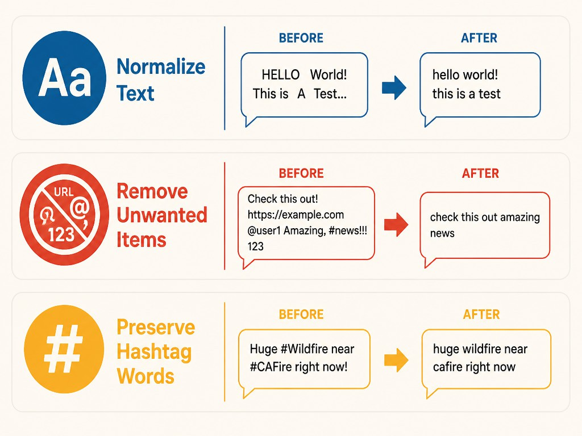
How Tweets Were Cleaned
Normalized the raw text
Lowercase every tweet so words match consistently across posts.
Collapse extra spaces to keep tokens clean and comparable.
Removed noisy patterns
Strip URLs and @mentions that rarely describe the actual event.
Drop punctuation and numbers to focus on meaningful terms.
Keeping hashtag meaning
Remove the # symbol but keep the hashtag word itself.
This preserves topic cues like wildfire or cafire in text.
Data Preparation and Feature Engineering

Slide 8
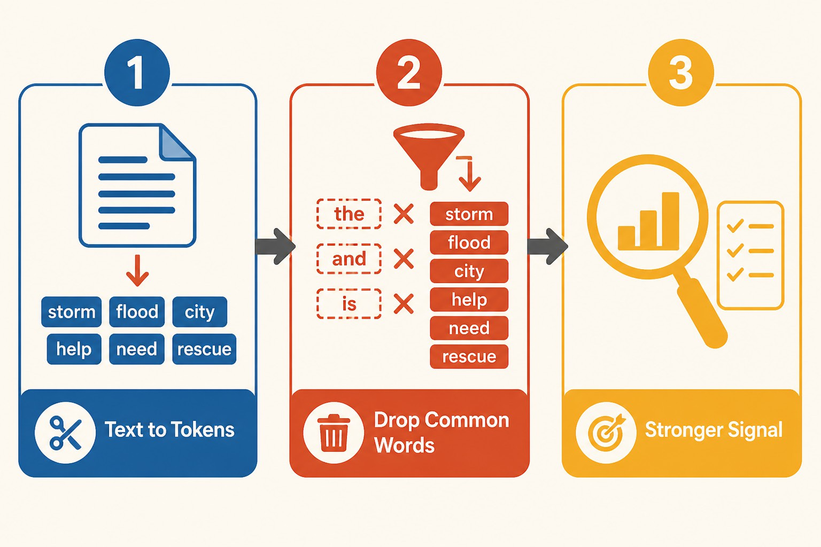
Preparing Model Text
Tokenize the cleaned tweet
Split each cleaned tweet into word tokens for consistent inputs.
This turns free text into units the model can count and weight.
Remove common stop words
Filter frequent words like “the” and “and” using an offline list.
Keep meaningful terms by dropping very short, low-signal tokens.
Result: cleaner signal
Less noise means TF-IDF focuses on informative disaster-related terms.
 | clean_text | tokens
0 | our deeds are the reason of this earthquake ma... | [our, deeds, are, the, reason, of, this, earth...
1 | forest fire near la ronge sask canada | [forest, fire, near, la, ronge, sask, canada]
2 | all residents asked to shelter in place are be... | [all, residents, asked, to, shelter, in, place...
3 | people receive wildfires evacuation orders in ... | [people, receive, wildfires, evacuation, order...
4 | just got sent this photo from ruby alaska as s... | [just, got, sent, this, photo, from, ruby, ala...
Data Preparation and Feature Engineering

Slide 9
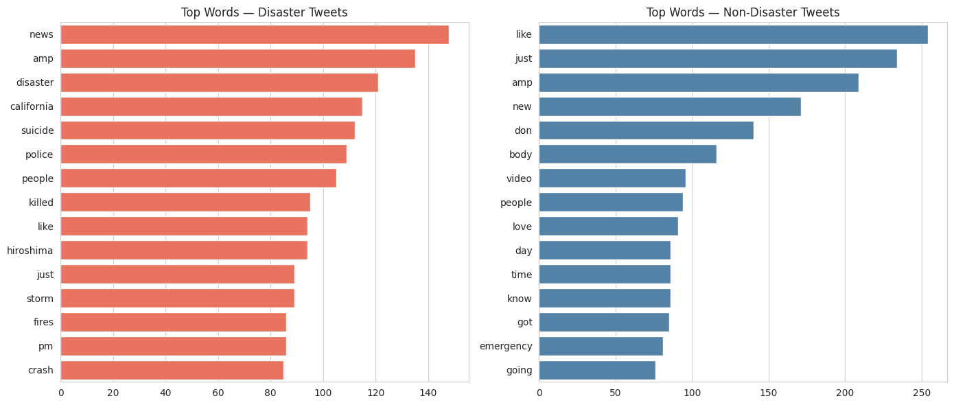
Language By Class
Words that signal real events
Disaster tweets often center on incidents like fire and emergency.
They commonly describe impact, response actions, and urgent updates.
Casual language in non-disasters
Non-disaster tweets use “disaster” terms as slang or exaggeration.
They tend to read like everyday conversation, jokes, or opinions.
Data Preparation and Feature Engineering

Slide 10
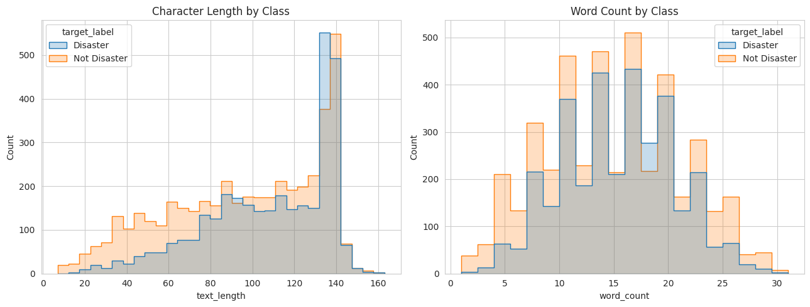
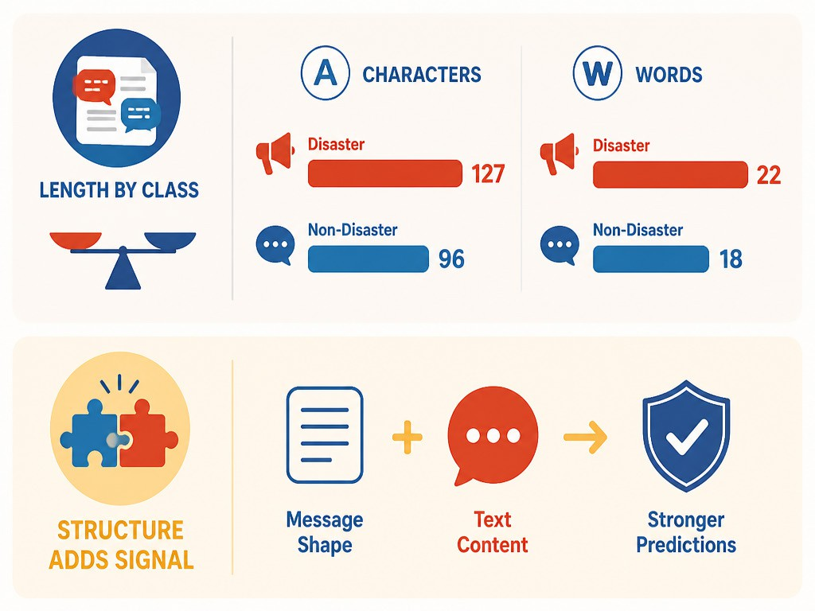
Tweet Structure Insights
Length differences by class
Disaster tweets trend slightly longer in characters and words.
Non-disaster tweets skew shorter and more conversational overall.
Structure adds signal
Length can help separate real events from casual “disaster” talk.
Combining structure with text features can improve classification reliability.
Data Preparation and Feature Engineering

Slide 11
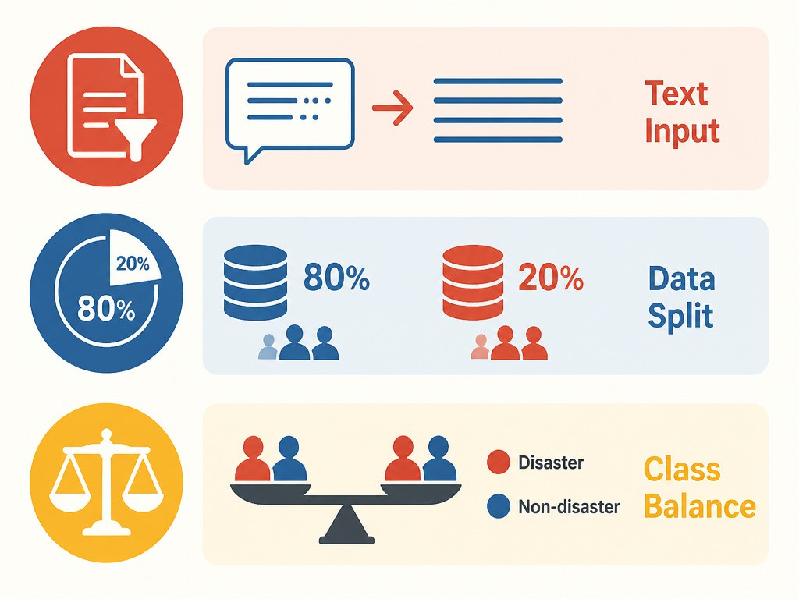
Train Test Setup
What went into the model
We used the cleaned, stop-word-reduced tweet text as input.
This keeps the pipeline focused on meaning, not formatting noise.
How the data was split
Tweets were split into 80% training and 20% testing sets.
The test set stays unseen until final performance reporting.
Keeping the classes balanced
A stratified split preserved the disaster vs non-disaster ratio.
This makes results more reliable when comparing models.
- Training rows : 6090; Testing rows : 1523
Modeling Setup

Slide 12
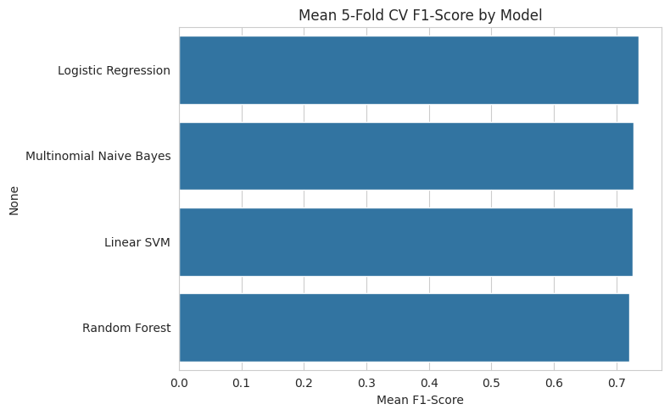
Models Compared
Algorithms evaluated
We compared Logistic Regression, Multinomial Naive Bayes, Random Forest, and Linear SVM.
Fair, consistent setup
Each model used the same TF-IDF feature pipeline for apples-to-apples testing.
Selection method
We used stratified k-fold cross-validation and focused on F1-score.
Best performer in CV
Logistic Regression delivered the top mean F1 at 0.735.
Fold-to-fold variation stayed low, indicating stable generalization.
How close were alternatives?
Naive Bayes, Linear SVM, and Random Forest scored just below.
The winner led by consistency, not a dramatic score gap.
Model Comparison and Selection

Slide 13
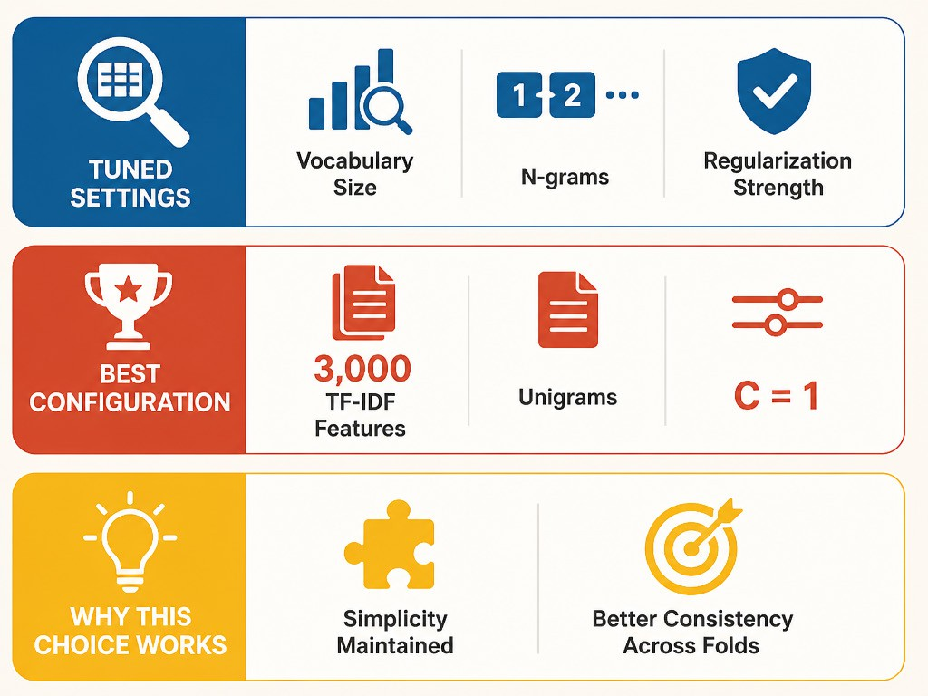
Tuning The Model
What we tuned
Grid search varied vocabulary size, n-grams, and regularization strength.
Best configuration found
Top settings: 3,000 TF-IDF features, unigrams, and C = 1.
Why this choice works
It kept the model simple while improving consistency across validation folds.
Model Tuning and Evaluation

Slide 14
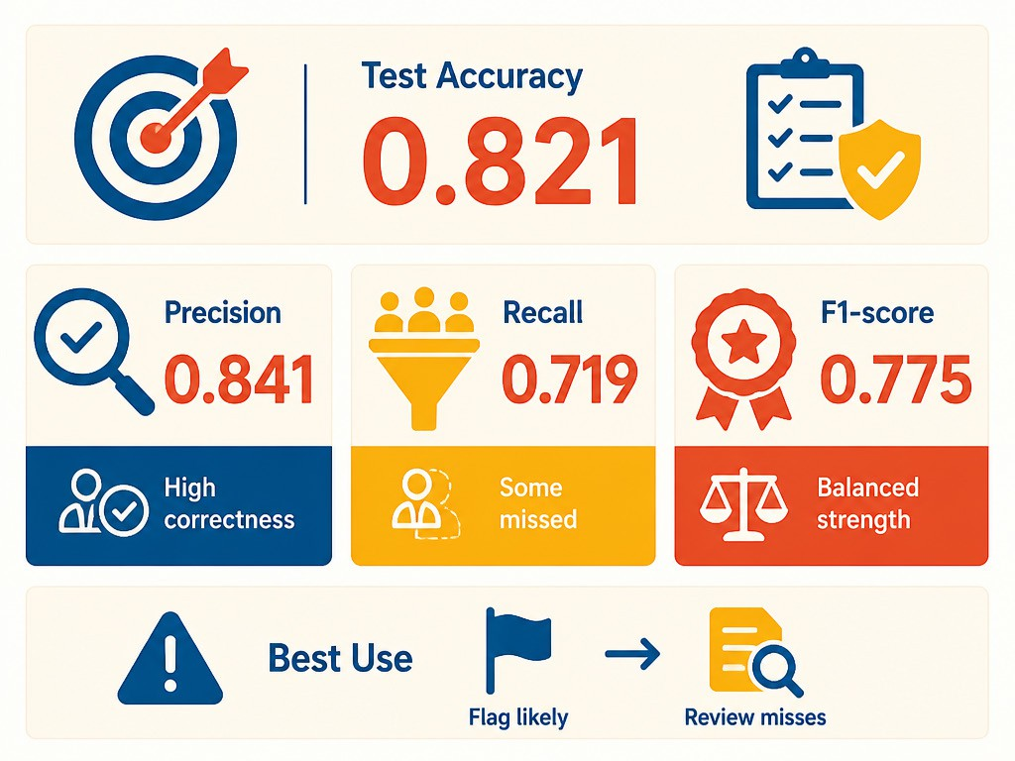
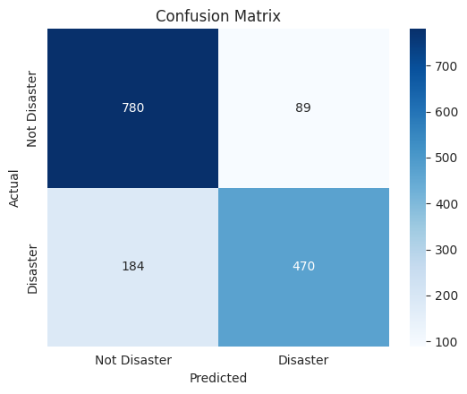
Test Set Performance
Headline results on unseen tweets
Overall test accuracy was 0.821 on the held-out set.
Precision vs. recall trade-off
Precision reached 0.841, so predicted disasters are often correct.
Recall was 0.719, meaning some real disasters were missed.
Balanced quality signal
F1-score was 0.775, reflecting overall detection strength.
Best fit for triage: flag likely disasters, then review misses.
What the error pattern suggests
The model misses real disaster tweets more often than it raises false alarms.
This creates a “quiet failure” risk when monitoring real-time events.
Model Tuning and Evaluation

Slide 15
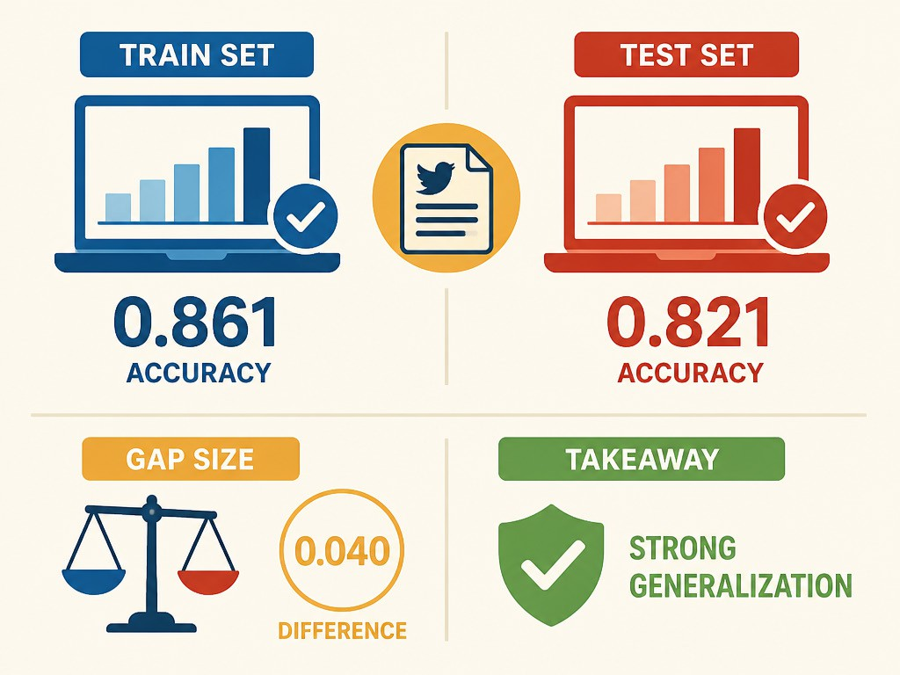
Generalization Check
Train vs. test alignment
Training accuracy reached 0.861, indicating a strong fit on seen tweets.
Test accuracy was 0.821, showing similar performance on new data.
What the gap implies
The train-test difference was about 0.040, a modest drop.
This suggests the classifier generalizes well rather than overfitting.
Model Tuning and Evaluation

Slide 16
Where The Model Struggles
Misclassifications in context
273 test tweets were labeled incorrectly, despite strong overall results.
Many errors come from limited context in short, standalone tweets.
Language the model misreads
Sarcasm and jokes can look like real emergencies in wording.
Metaphors like “this is a disaster” blur the intended meaning.
What this means in practice
Human review remains important for ambiguous, high-impact alerts.
Model Tuning and Evaluation

Slide 17
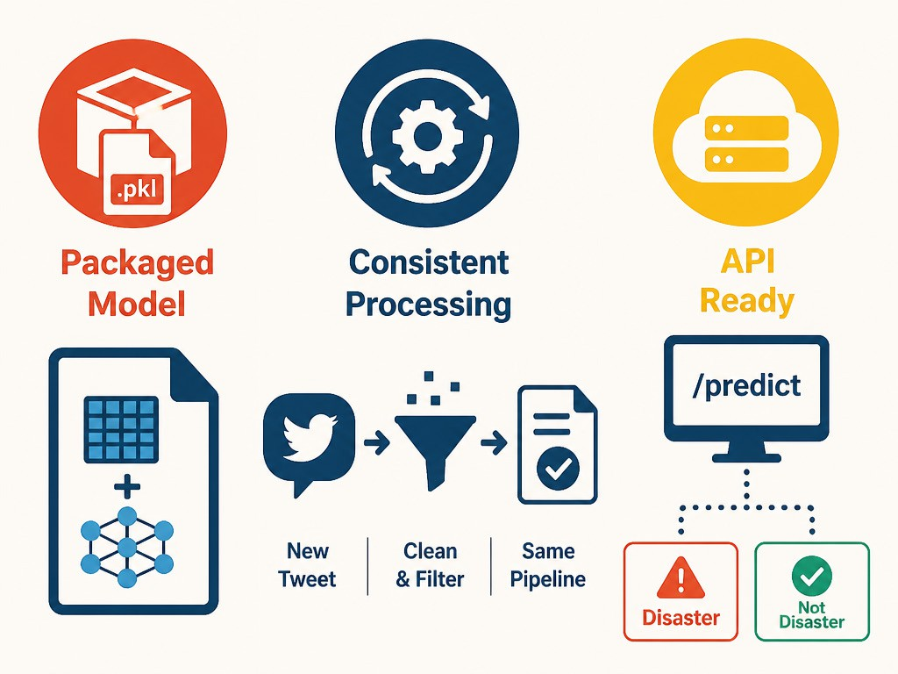
Deployment Ready Output
Packaged model artifact
The vectorizer and classifier are stored together as a single pickle file.
Consistent inference steps
New tweets run through the same cleaning and stop-word removal logic.
This prevents training-serving mismatch and keeps predictions reliable.
Ready for an API
Load the pickle in a backend service and expose a /predict endpoint.
Return a clear label: Disaster or Not Disaster.
Deployment and Real World Use

Slide 18


